Slide 1
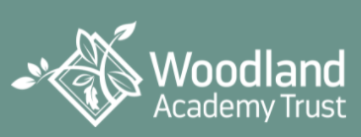

Meet the Teacher Session
Year 6 Larch Class
Wednesday 20th September 2023

Slide 2
Session Aims
To introduce class teacher and teaching assistant
To talk through daily routines and weekly timetable for the coming year
Year 6 Curriculum overview for 2023 2024
Overview of new Relationships and Behaviour Policy
Expectations re uniform, attendance, punctuality and home learning
Time for questions

Slide 3
WELCOME TO YEAR 6
Larch CLASS
Class Teachers – Mr Poole & Ms Cummings
Teaching Assistant(s)- Mr Jay

Slide 4
Daily Routines
School gate opens at 8:40am
Children brought to external door (KS1) and then enter classroom
Early morning work
Whole school assemblies Monday, Wednesday and Friday mornings 9:00-9:20am
Breaktime –KS2 11:00-11:15am
Lunchtime – 12:30-1:30pm
Children collected from playground at 3:20pm

Slide 5

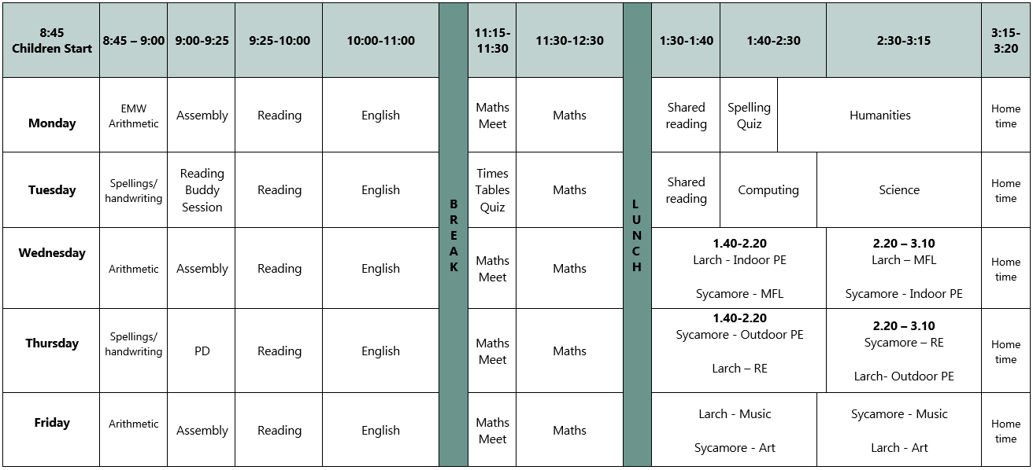
Weekly Timetable example

Slide 7
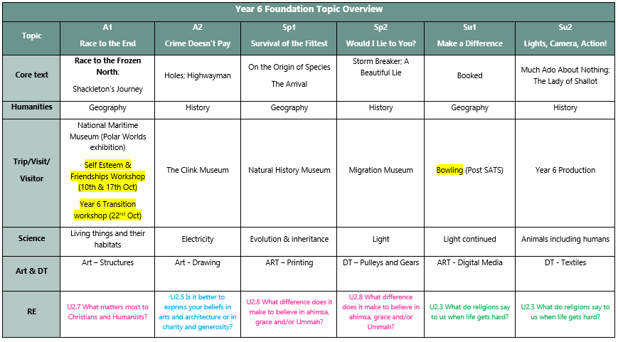
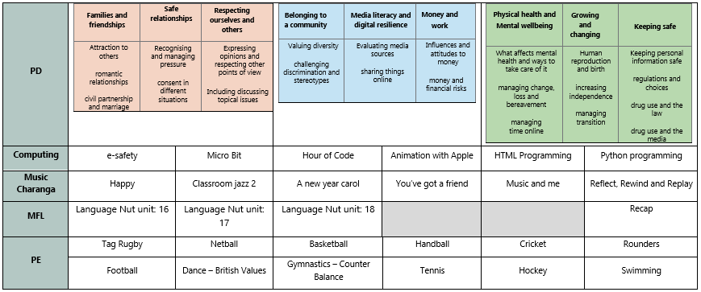
Curriculum Overview

Slide 8
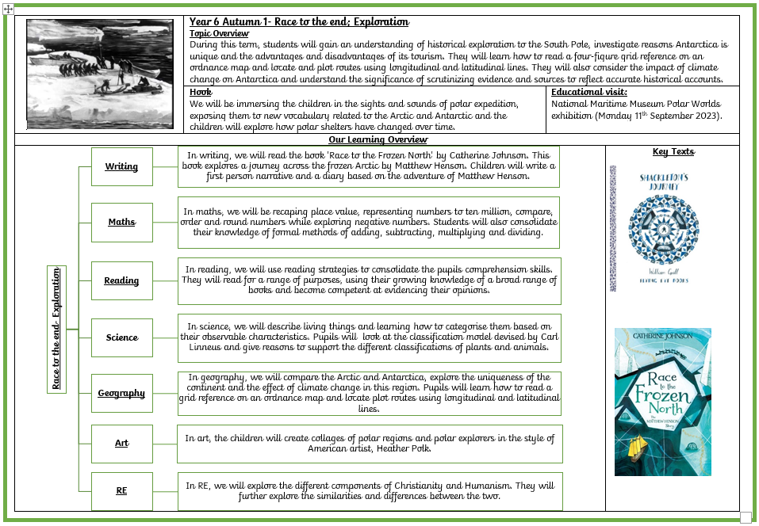
Autumn Term Overview

Slide 10
Relationships and behaviour at wbp – our vision
At Willow Bank Primary School, our vision is to create a learning environment where all pupils feel safe, secure and able to make the biggest possible contribution towards their own learning and that of others. We believe that by working together, we can establish a climate where all learners work collaboratively and in partnership to ensure the quality of learning is of the highest standard.
We believe that our core values : respect, integrity, kindness, resilience, aspiration, and curiosity are central to building positive relationships and excellent learning behaviours within our school community.

Slide 11
A positive behaviour approach at Willow Bank Primary School
Recognition Wall – to celebrate children demonstrating our core values: respect, integrity, kindness, resilience, aspiration and curiosity
Celebration Assemblies -every Friday
Golden wristbands to celebrate exceptional effort – reason written onto wristband
Attendance rewards
House Points – one house point given at any one time recorded on the Dojo platform
Positive postcards home
Positive phone calls home
Informal conversations with parents at the end of the day
Photocopying learning to go home with a brief note from the teacher

Slide 12
Our behaviour steps
Step 1.
Rule reminder
Step 2.
Warning
Step 3.
Reflection time in class (5 mins KS1, 10 mins KS2).Lost learning time to be made up at next break/lunchtime.
Step 4
Reflection time in partner class (5 mins KS1, 10 mins KS2).Lost learning time to be made up at next break/lunchtime.
Step 5
RESET, RESTORE and RETURN to LESSON . Well Being Coach is called to collect child to complete their reflection time in the Sanctuary/Inclusion Room or is taken for a walk and talk and returned to class within 15 minutes
Step 6
SLT called. Child remains out of class for the rest of the session.

Slide 13
UNIFORM
We are proud of our school and our uniform which enables our children to have a sense of belonging to our wonderful school community.
Girls
Royal blue cardigan with the school emblem or plain royal blue cardigan
White polo short with the school emblem or plain royal blue cardigan
Grey skirt/pinafore or smart grey trousers (not fashion trousers) and grey socks.
Blue and white school dresses/skirts or shorts may be worn in the summer with white socks
Flat, black sensible school shoes
Plain hairbands- no bows please

Slide 14
uniform
Boys
Royal blue jumper with the school emblem or plain royal blue jumper
White polo short with the school emblem or plain white polo shirt
Grey trousers and grey socks
Grey shorts may be worn in the summer term
Black school shoes (no boots or trainers)

Slide 15
PE KIT- may be worn to school on pe days
White, round necked t-shirt with the school emblem or plain white round necked t-shirt
Royal blue shorts
Plimsols for indoor PE, trainers for outdoor PE
PE bag with a drawstring top
Royal blue tracksuits may be worn outside in cold weather
Reception only: navy outdoor all-weather anorak and trousers
Please ensure all items of clothing –including shoes and coats- are labelled clearly with your child’s name

Slide 16
Uniform
Book Bags
All children are expected to bring a book bag* or rucksack* to school every day so they can keep reading books, letters and homework safe and dry
Jewellery
Watches may be worn in Year 3 and above- not smart watches please.
One pair of stud earrings (which will be removed during PE by the child). Please note that staff are not permitted to remove earrings.
Please note that mobile phones, tablets, iPads and all other mobile devices are not permitted in school unless your child has permission to walk home alone in Year 5 or 6. Phones are switched off and kept in the school office during the day.

Slide 17
punctuality
At Willow Bank we monitor every child’s attendance and punctuality very closely to ensure the children maximise every learning opportunity.
Please ensure your child is in school on time every day. Gates open at 8:40am and are closed at 8:50am.
Arriving to school on time is very important as this will create good habits for the future and establish positive routines. It also ensures other children in the class are not disrupted who have already settled down to their learning.

Slide 18
attendance
If your child is ill and unable to come to school, please phone the school office from 8:00am in the morning to inform us of the reason your child is absent. We will call you if we do not receive a phone call.
During the academic year Mrs Edgar, our Community Liaison Officer, will be monitoring and tracking pupils’ attendance. Our aim is to work together with children and parents in order to ensure high attendance across the whole school. This will result in your child getting the most from their education and lead them to future success.
Please be aware that in accordance with our policy on absence during term time, if you take your child out of school for an unauthorised absence during term time, it is possible that a Penalty Notice will be issued to each parent for each child taken out of school, as stipulated in the Education (Penalty Notices) (England) Regulations 2007.

Slide 19
Home learning
At Willow Bank Primary School we recognise that parents make an enormous contribution in supporting the education of our children. Parental encouragement is a key factor to raising attainment and fostering a love of learning.

Slide 20
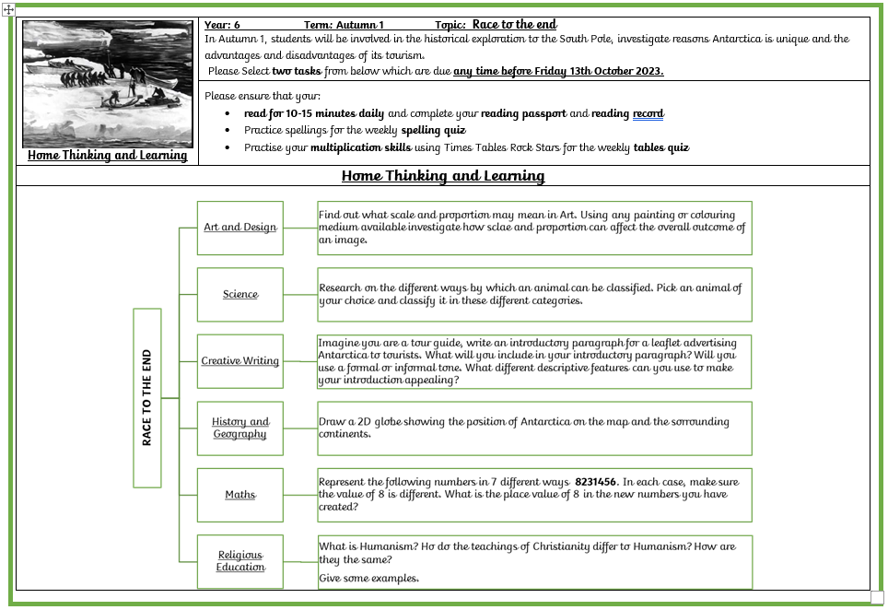
Autumn Term home learning

Slide 21
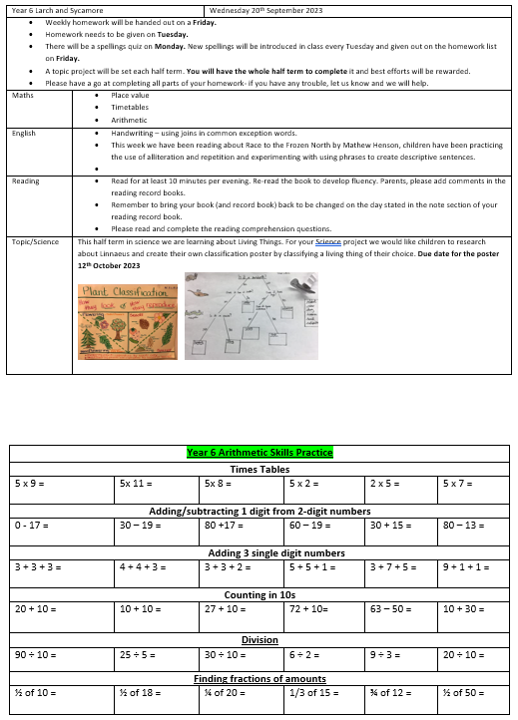
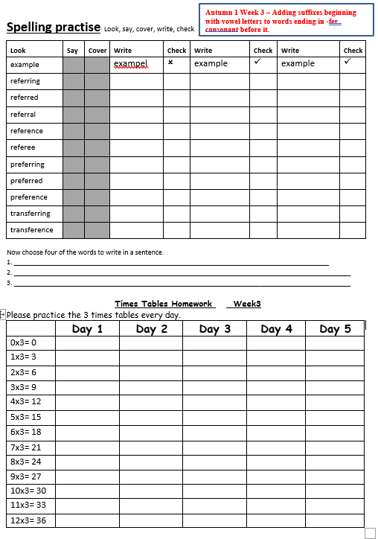
Weekly home learning

Slide 22
Daily Home learning activities
Daily reading with your child or encouraging an older child to read independently. It is important that children read books at their level to develop fluency and also enjoy books read by an adult for pleasure.
Times tables are essential for children to progress in their maths learning. A statutory test in Year Four has also now been introduced and it is expected that all children will know their times tables up to 12x12. Each child in the school has a log in for Times Tables Rockstars to practise at home or you can play your own times tables games, ensuring that children can say them out of order and quickly.

Slide 23
Reading at willow bank
At Willow Bank, children have access to a wide range of books in their reading corner and are encouraged to take a new book home to read every week (unless they haven’t finished/want to keep their previous book).
Children should be reading at home every day for fifteen minutes. Please do write a comment in your child’s home/school book or encourage them to do so each time you read with them
Every class has daily reading sessions – early reading in EYFS and KS1 and whole class reading in KS2
Every class has a daily story time for 15 minutes during which the class teacher or TA will read aloud from the class book
This year we have introduced Reading Passports to encourage reading for pleasure. Every minute your child reads equates to one mile on their passport. Please initial your child’s passport every time they read at home.
Children that complete their Bronze, Silver, Gold, Platinum and Diamond passports will become a Willow Bank Reading Ambassador and will help to lead initiatives to encourage every child to be a life long reader

Slide 24
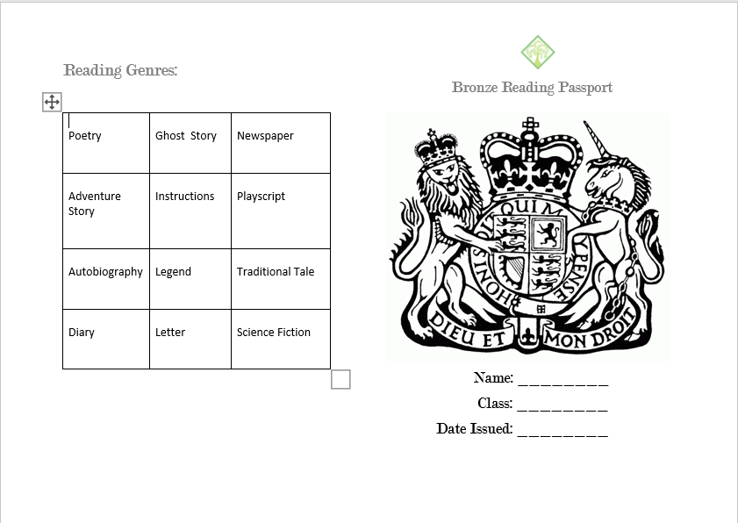
WBP Reading Passports

Slide 25
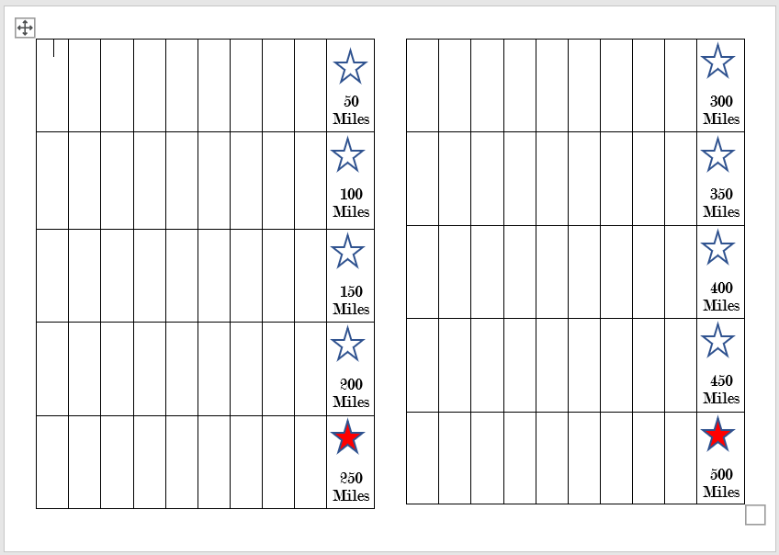
WBP Reading passports

Slide 26
Year group expectations for times tables:
Y1: count in 2, 5, 10 (all doubles to 10 and halves)
Y2: 2, 5, 10, 3 (rapid recall in any order e.g. 2 x 5, 5 x 10, 4 x 3)
Y3: 2, 5, 10, 3, 4, 8
Y4: All up to 12 x 12
Y5: All up to 12 x 12
Y6: All up to 12 x 12
Daily reading and practicing times tables will help your child in their learning immensely and increase their confidence in school.

Slide 27
communication
All children have been given a reading journal. This can also be used for messages to be communicated between home and school. Please write a brief comment in it each evening when you read with your child.
I will be on the playground at the end of every day if you need to give me any quick messages regarding your child. If you need more time to discuss a query or issue, please do make an appointment to see me by calling the school office on 0208 320 1900.
In addition, we will send home half termly curriculum newsletters, a weekly parent newsletter and there is lots of additional useful information on our new school website Contact Us - Willow Bank Primary School

Slide 28


Children’s University is a charity that works in partnership with schools to develop a love of learning in children.
We do this by encouraging and celebrating participation in extra-curricular activities in and outside of school.
By the time a child turns 18, they will have spent just 9% of their waking life in a classroom. Children’s University is about making the most of the remaining 91%.

Slide 29
Children graduate each year once they’ve earned enough stamps.
Children earn stamps by:
Doing activities at home- check
a).Children’s University
google classroom.
b). Children’s University
website.
Participating in after school clubs in school.
Participating in after school clubs outside school
Key outcomes we want for every child
We want every child that takes part in Children’s University to feel:
  That learning can be fun, aspirational, and lifelong
  They have enjoyed a range of new learning experiences and are motivated to keep learning in different ways
  They have grown in confidence and self-belief
  They have a broader range of essential skills in line with the Skills Builder Framework
  They are empowered to make positive choices about their future
  They can better cope with the challenges that life throws at them
  They are celebrated for their commitment to learning by their family, school, and community.

Slide 30
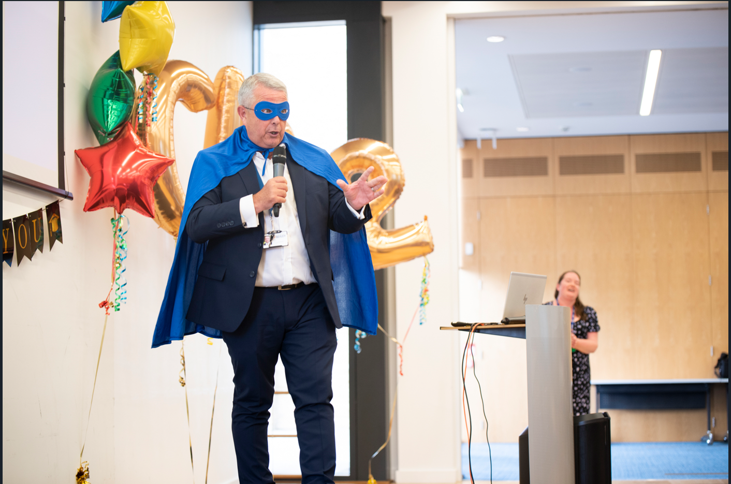
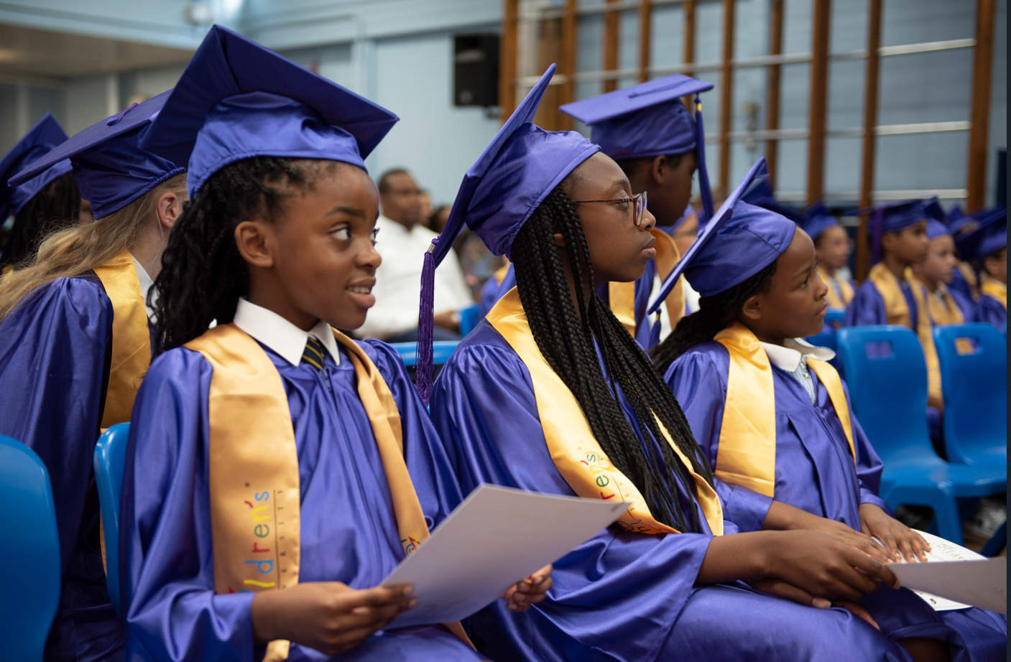
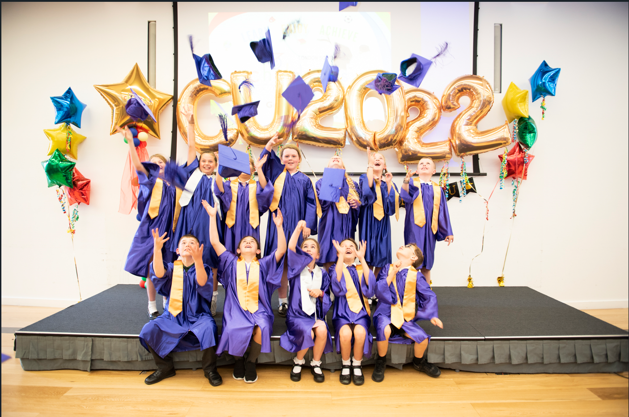

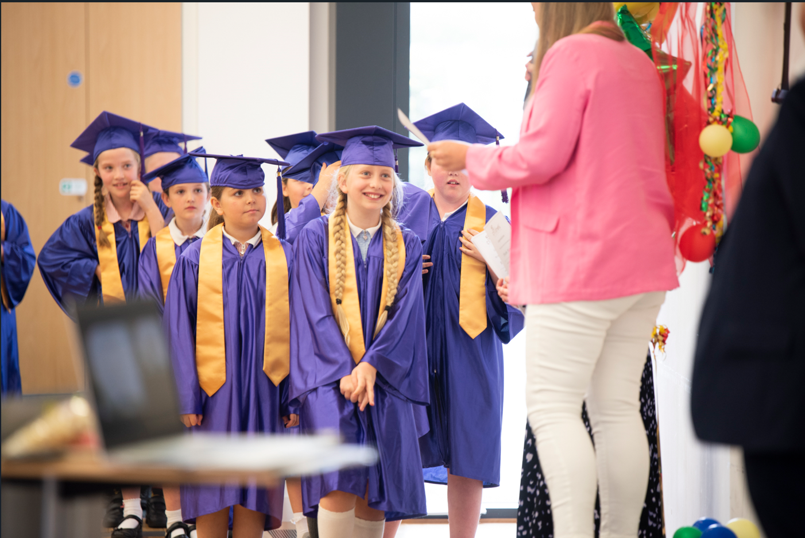
limitless learning beyond the classroom
GRAduation ceremony

Slide 31
Additional information needed
Secondary application deadline – Tuesday 31st October 2023
Offer Date – Friday 1st March 2024
Y6 SATs – week commencing 13th May 2024

Slide 32
Thank you for listening
Please do come and speak to me if you have any further questions.

